Slide 1

Microsoft and Machine Learning
Andrew Moll
@AskTheData

Slide 2
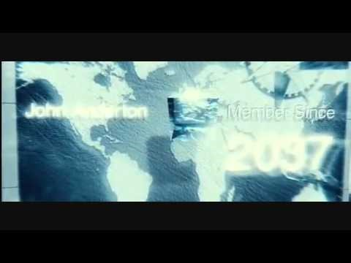

Slide 3


Slide 4
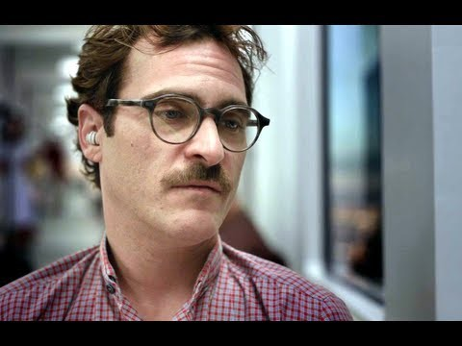

Slide 5
“Does the science fiction influence the science, or does the science influence the science fiction?” -Harry Shum

Slide 6

Microsoft & Machine Learning Answering questions with experience
1991
1997
2008
2009
2010
2014
2014
Microsoft Research formed
Hotmail launches
Which email is junk?
Bing maps launches
What’s the best way home?
Bing search launches
Which searches are most relevant?
Kinect launches
What does that motion “mean”?
Skype Translator launches
What is that person saying?
Azure Machine Learning launches
What will happen next?
“
Everything we do now is influenced, one way or another, by machine learning.
Peter Lee, Microsoft Director of Research
”
Notes:
Microsoft has been working on machine learning for over two decades. We formed Microsoft research back in 1991 to tackle the tough problems internally that we’re enabling you to tackle yourselves today.
When we think of learning from experience – past data + human input – a great example is Hotmail. Back in 1997, external email was a relatively new concept. There wasn’t a lot to go on in terms of what email the customer wants and what they do not. With the rise of email, also came spam – and lots of it. Some of those issues were easy – like Nigerian princes we learned pretty quickly don’t give away their fortunes to strangers. But what about “free offer” – maybe that free offer is something the customer always wanted. Maybe it’s something they’d never want. But that’s where the “human input” part comes in as data is being collected – that takes the form of the actual user of the email service saying “yes, this is junk” or “no, I want this” and then the data scientist learning in aggregate and making tweaks to the underlying model in response.
And we kept going with that learning – relying on past data and human input to solve problems like the best way home, which search results are most meaningful to the user and one of the toughest ones to tackle with Kinect. Kinect’s past data was all in the lab – we didn’t have a product in market that captured user input and translated that to active game play so we had to make up the variables. But that only takes us so far. The researchers told me that one thing they didn’t consider was people answering the phone while playing. This happens a lot – and Kinect at first was translating this as a wild motion in the game play – essentially crashing people’s cars or any number of unintended consequences. That was the human input we rely on, which allowed us to learn quickly and adjust the underlying model to ensure that answering the phone would not be considered part of the game moving forward.
Skype translator is another huge machine learning problem to solve if you think of all the ways a person who is speaking English can pronounce the same word – tom-A-to or tom-AH-to – that’s the same word in French so Skype has to adjust quickly to ensure all the millions of variables are considered.
But what about using all this learning to predict what’s next? Many of the same algorithms running behind the scenes of our products in market today are available within Azure ML, allowing you to take your own past data and learn from it what will happen in the future for your business.

Slide 7
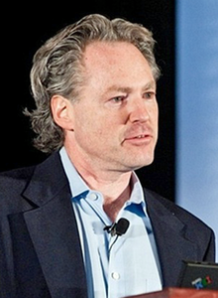

Who’s making this happen?
Notes:
Lee has also done a lot with deep neural networks. Dr. Peter Lee, Corporate Vice President, Microsoft Research, is responsible for Microsoft Research New Experiences and Technologies, or MSR NExT, an organization of world-class researchers, engineers, and designers devoted to creating potentially disruptive technologies for Microsoft and the world. While NExT will continue to advance the field of computing research and produce work with significant scholarly impact, its priority is developing technologies that benefit Microsoft and the world more broadly.
In this role, Lee oversees Microsoft Research Asia, Microsoft Research Technologies, FUSE Labs, and Microsoft Research Special Projects, along with several incubation project teams.
Prior to joining Microsoft, Lee has held key positions in both government and academia. His most recent position was at the Defense Advanced Research Projects Agency (DARPA), where he founded and directed a major technology office that supported research in computing and related areas in the social and physical sciences. One of the highlights of his work at DARPA was the DARPA Network Challenge, which mobilized millions of people worldwide in a hunt for red weather balloons — a unique experiment in social media and open innovation that fundamentally altered the thinking throughout the Department of Defense on the power of social networks.
Before DARPA, Lee served as head of Carnegie Mellon University's nationally top-ranked computer science department.
“I honestly can't think of any recent product development that Microsoft has been involved in that hasn't involved machine learning,” says Microsoft’s director of research, Peter Lee, who left DARPA to run Microsoft’s research arm. “Everything we do now is influenced, one way or another, by machine learning.”
Horvitz received his PhD in 1990 and his MD degree at Stanford University.^{[2]} His doctoral dissertation, Computation and action under bounded resources, and follow-on research introduced models of bounded rationality founded in probability and decision theory. He did his doctoral work under advisors Ronald A. Howard, George B. Dantzig, Edward H. Shortliffe, and Patrick Suppes.
He is currently Technical Fellow at Microsoft, where he serves as director of Microsoft Research's main Redmond lab. He has been elected Fellow of the Association for the Advancement of Artificial Intelligence (AAAI), the National Academy of Engineering (NAE), the American Academy of Arts and Sciences, and of the American Association for the Advancement of Science (AAAS). He was elected to the ACM CHI Academy in 2013 and ACM Fellow 2014 For contributions to artificial intelligence, and human-computer interaction.^{[3]}
He was awarded the Feigenbaum Prize, a biennial award for sustained and high-impact contributions to the field of artificial intelligence through the development of computational models of perception, reflection and action, and their application in time-critical decision making, and intelligent information, traffic, and healthcare systems.
He serves on the Scientific Advisory Committee of the Allen Institute for Artificial Intelligence (AI2) and is also chair of the Section on Information, Computing, and Communications of the American Association for the Advancement of Science (AAAS).
He has served as president of the Association for the Advancement of AI (AAAI), on the NSF Computer & Information Science & Engineering (CISE) Advisory Board, and on the council of the Computing Community Consortium (CCC).
The last several years, you could describe it as machine learning meets health/biology. We like to find problems where it’s high impact, important for society, and where there’s no solution yet. We like to come in, work with scientists and get a feel for what they’re doing, see where they’re lacking the tools to do what they want to do, and fill those gaps.

Slide 8
Where are we going?

Slide 9

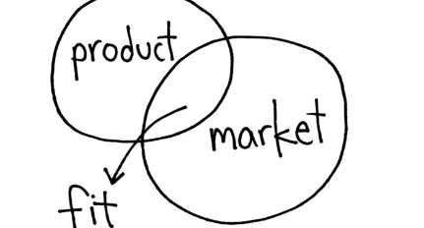

Our Competitive Advantage:
Help Startups Grow in Each Lifecycle Stage
Discovery
through ecosystem
Validation
through accelerators, VCs
Growth
through success mgmt, VCs, BD
Notes:
Our Comp Advantage? Microsoft is uniquely positioned to help startups grow through every stage of their lifecycle. AWS or GCE can’t do this.
We informally do a lot in the discovery stage through informal activities in the ecosystem … we focus heavily on validation … and we are going to add on to the alumni and cap program this year.

Slide 10









How DX Influences the Startup Ecosystem
Tier 2 Accelerators
100,000 startups on BizSpark
Tier 1 Accelerators
30 VCs
Growth
7 Accelerators around the world
Validation
Discovery

Slide 11
A Few Key Stats
410
100+
Companies have gone through our 7 accelerators to date
VCs targeted globally for portfolio reviews
$1.2B
79%
Follow-on funding received within 1 year of Demo Day (Industry average is 59%)
Raised by our alumni to date!
$3.7M
Average funding raised a year from graduation ($735K median in funding)
28
Startup exits: 27 acquisitions to-date (one by Microsoft) and 1 IPO
Notes:
When I started ….
But then I asked what could we do more of or differently ….

Slide 12
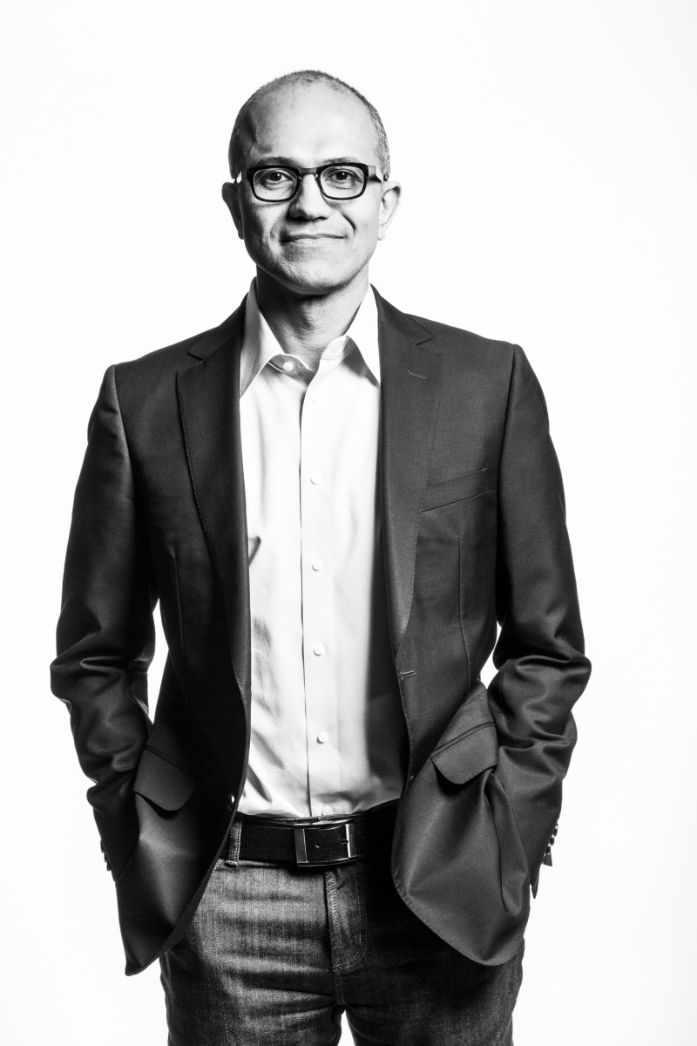
Satya on Startups
… I would love to be here in a year’s time talking about a new company in the Middle East or anywhere else that built a … service …that is competing against companies like Amazon or Netflix… and built on the Azure capabilities…
April 2015 Q&A with Satya

Slide 13
THANK YOU!

